Slide 1



Unreal Expectations
Midterm Progress Presentation

Slide 2
A moment of silence
R.i.p. Juan Valenzuela
2018-2019

Slide 3

Team mascot

Slide 4
End goal
Create a feature-minimalist but graphics-maximist game in the spirit of Fire Emblem. The features encompassed buy that idea includes but is not limited to:
Solid volumetric fog of war
Two player interactions
Two armies, one per player
Unit pathfinding, statistics, and combat
Win condition: annihilate other army
And others

Slide 5
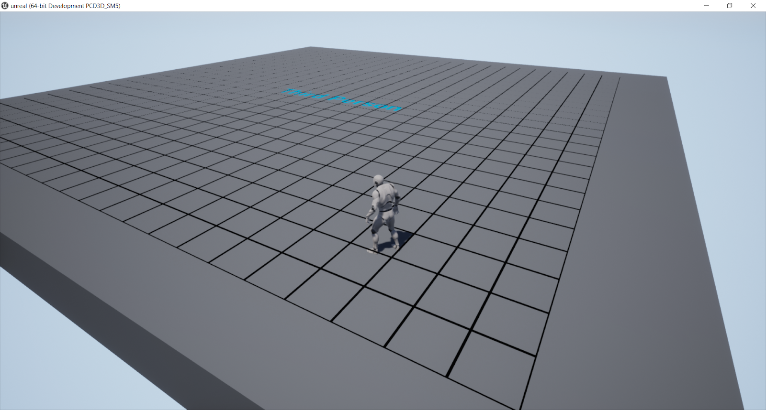
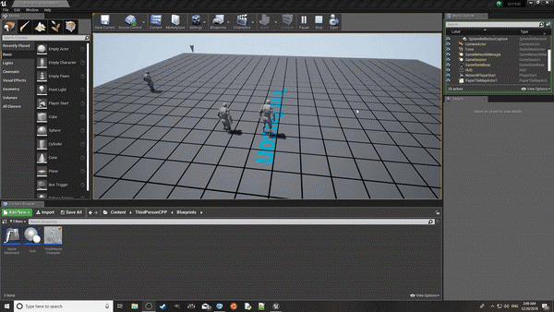
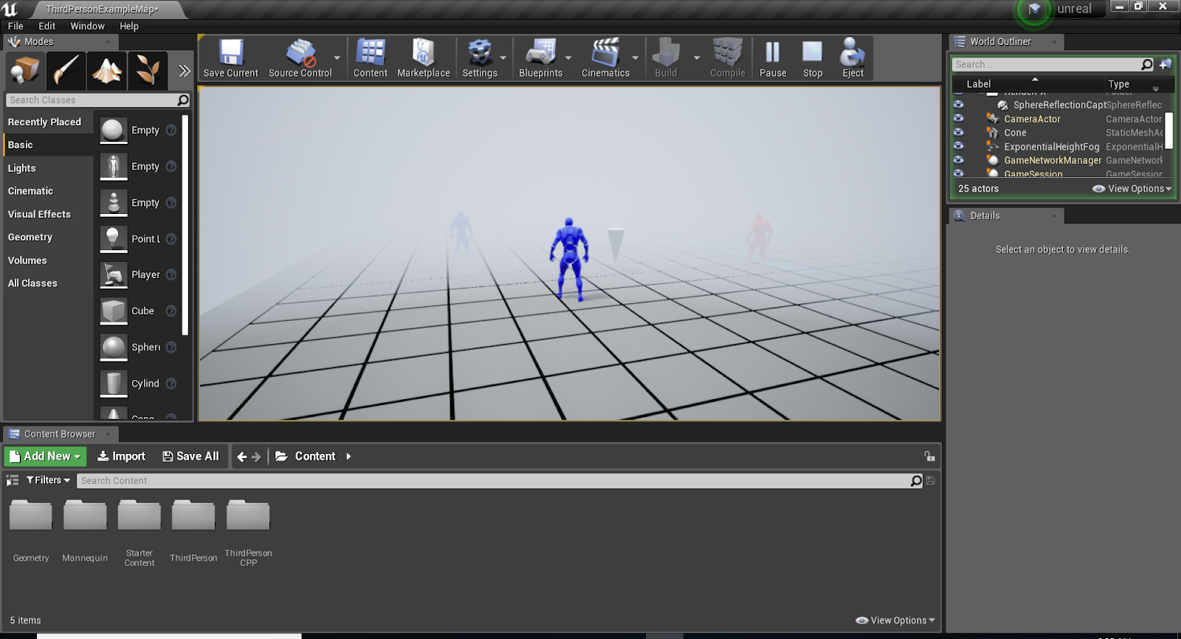
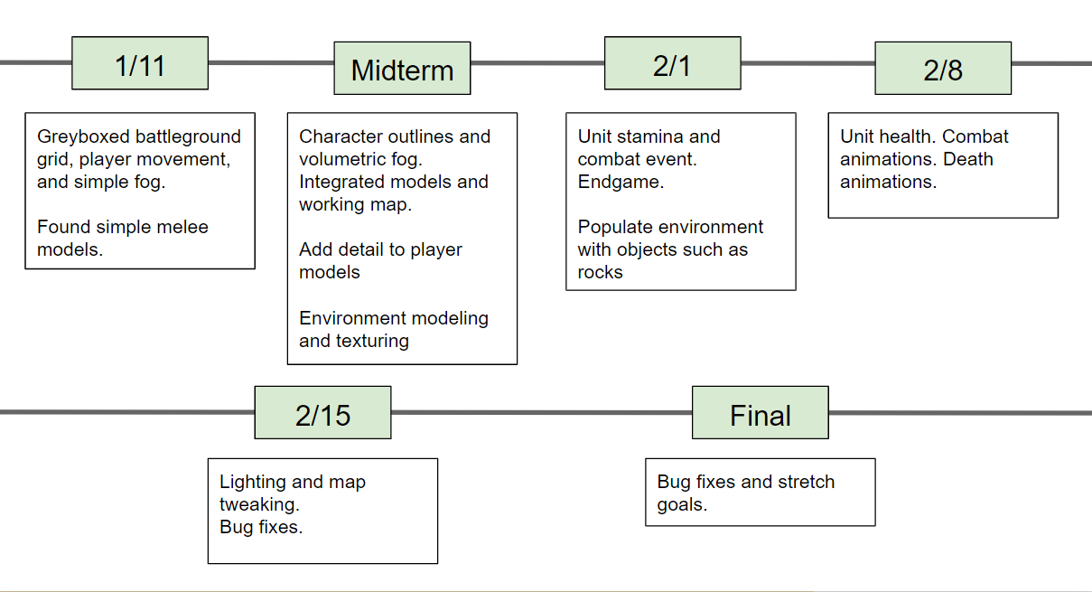
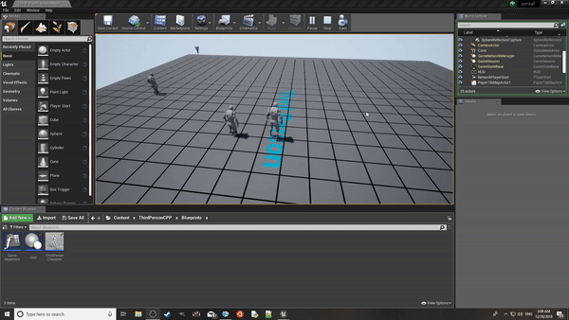
Progress recap

Slide 6
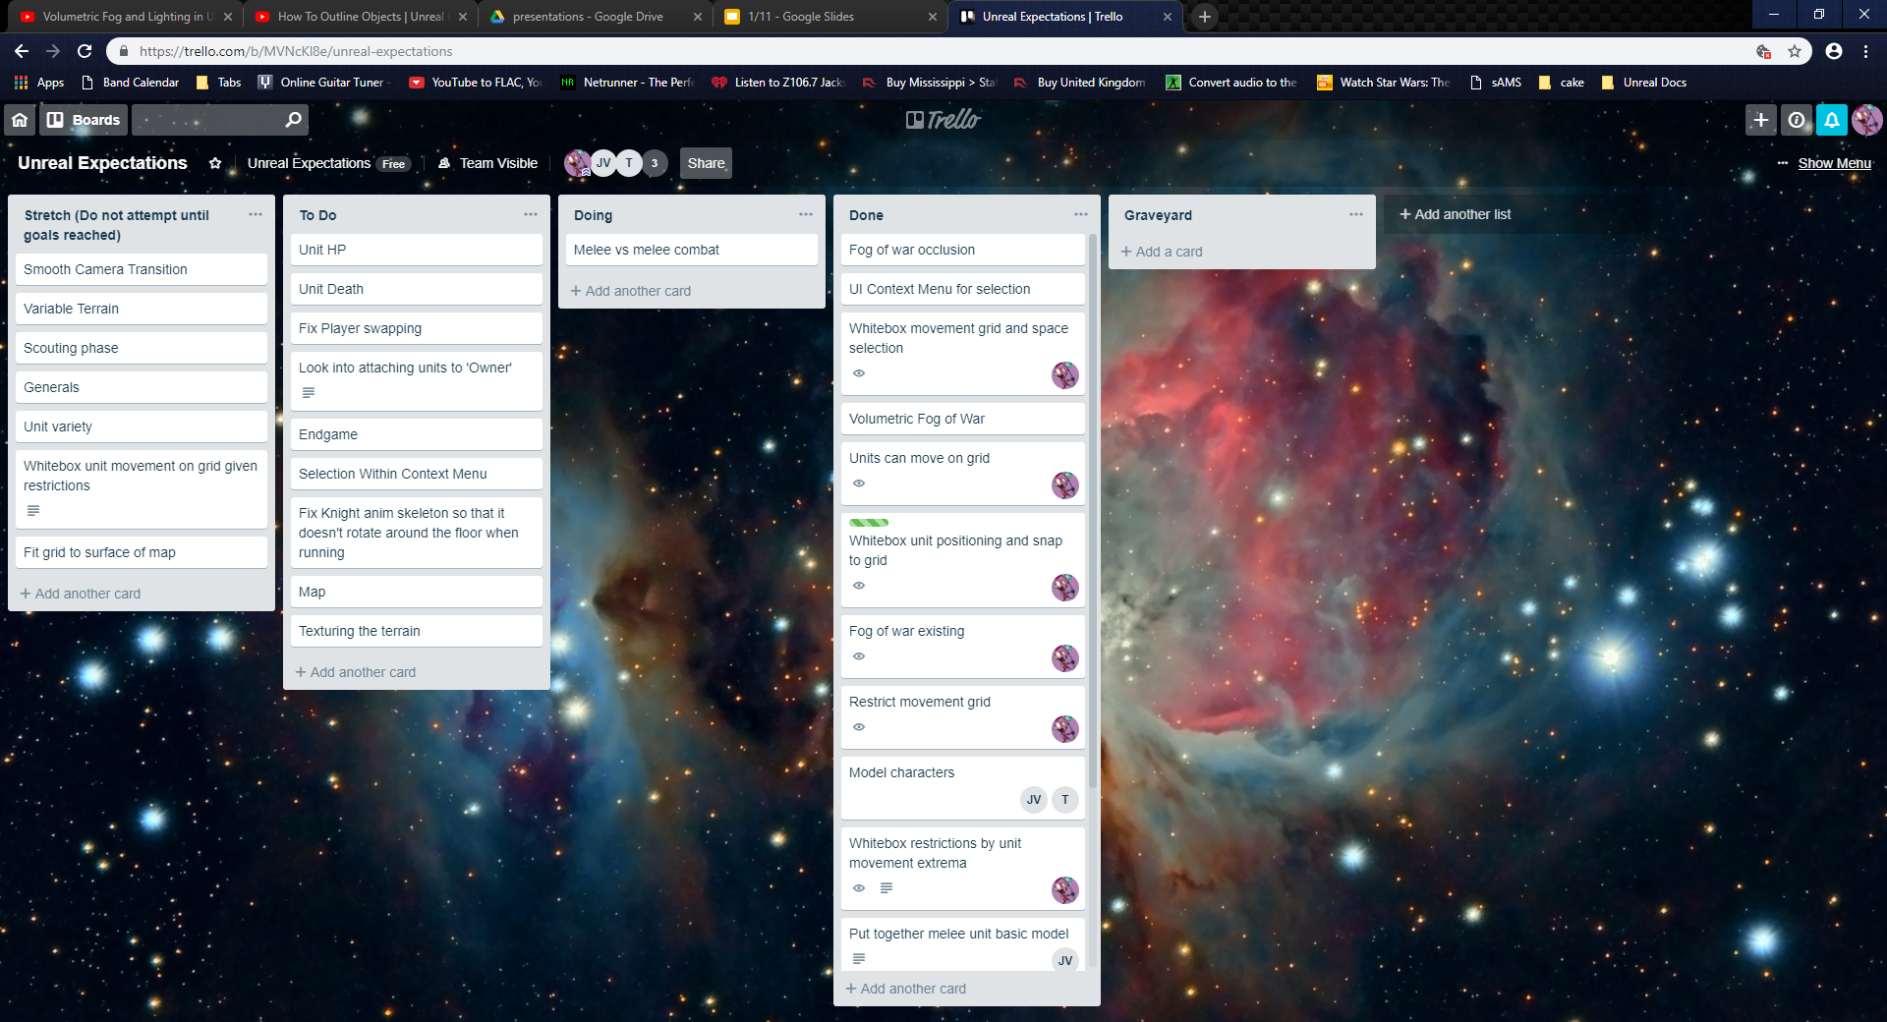
TRell

Slide 7
new timeline
2/1
2/8
2/15
FINAL
I am here
Combat
Unit HP
Unit Death
‘Turning’
Endgame
Finish GUI
Maybe smooth camera transition
How about a map that is not a grey tetrahedron with a grid on it?
Bug Fixes
Tweaks
Improvements
Stretch Goals

Slide 8
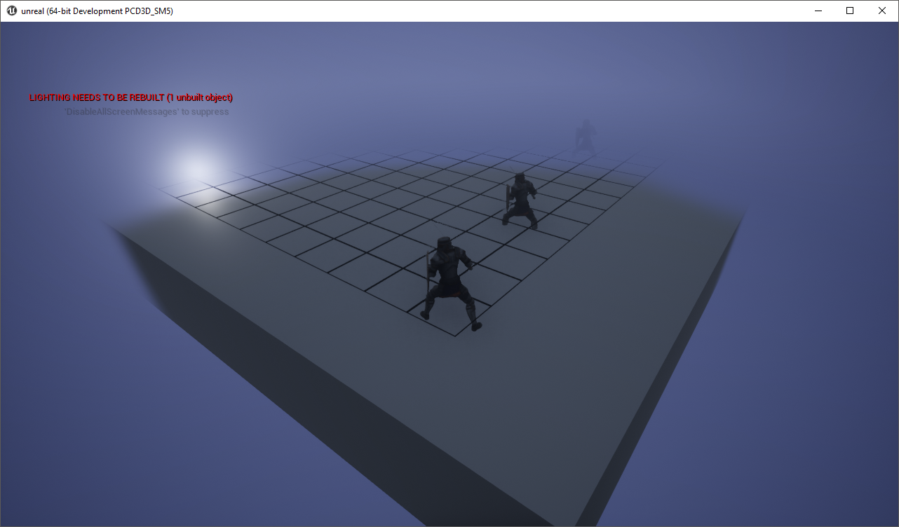
Volumetric Fog of war
Still uses the basic fog from last time, however the volumetric checkbox is turned on. A particle emitter was created using a custom-defined material volume (the clouds).
The emitter spawns the clouds in an area that orbits the player.
https://www.youtube.com/watch?v=Xd7-rTzfmCo

Slide 9
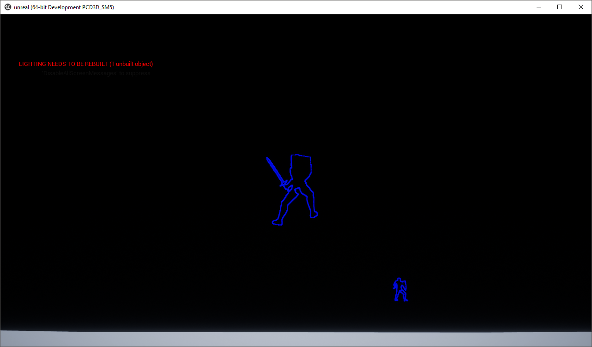
Postprocessing outlines
This is a material I downloaded off of a nice polish guy’s website. It utilizes something called ‘Render Custom Depth’ whatever that means.
https://www.youtube.com/watch?v=9fxnv2ccklg

Slide 10
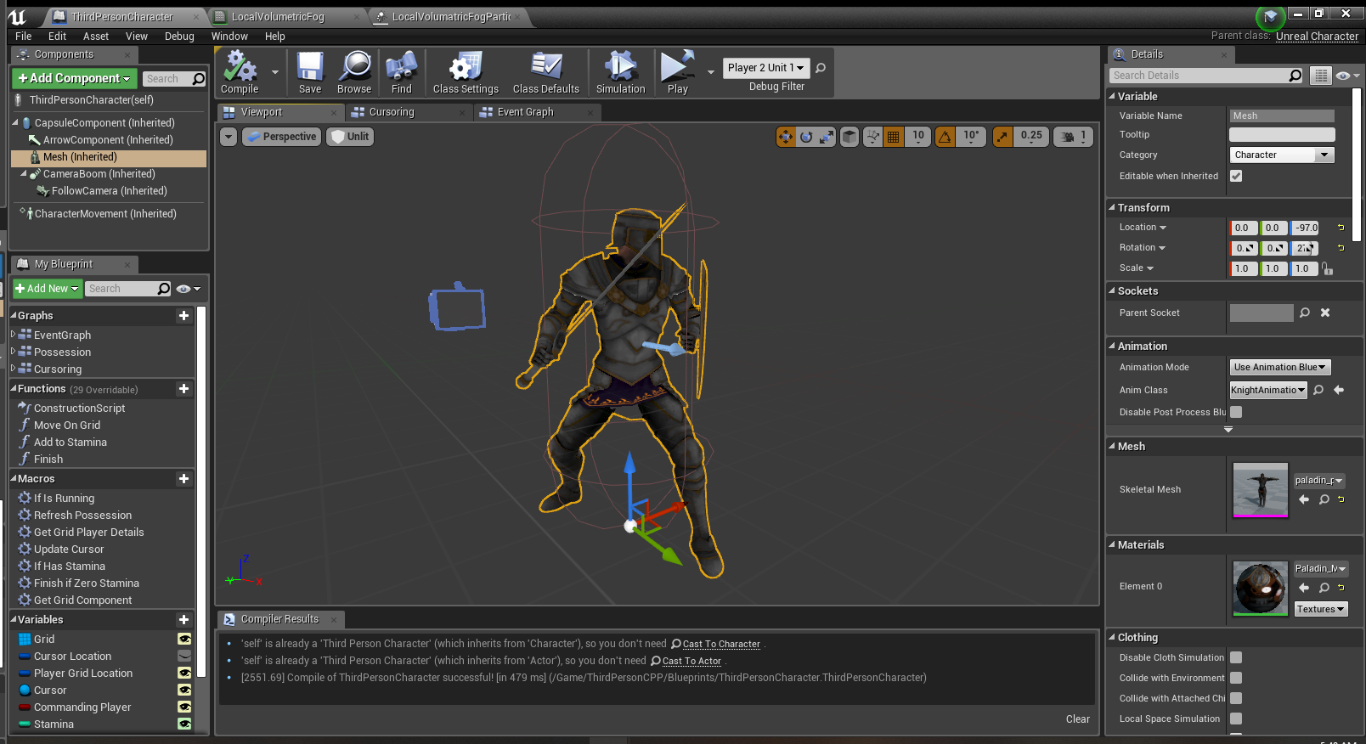
Knight Model
Courtesy of Mixamo

Slide 11
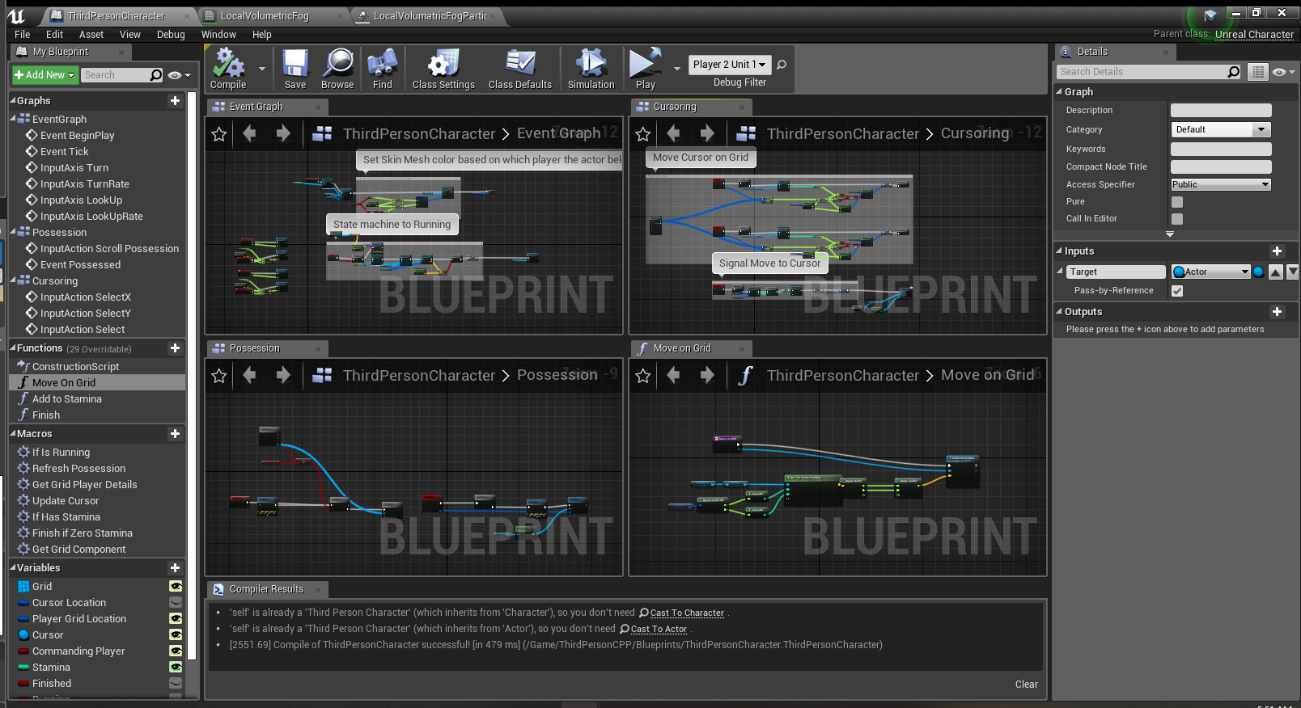
A Feel for my blueprints

Slide 12
D D D o A E M O

